Slide 1
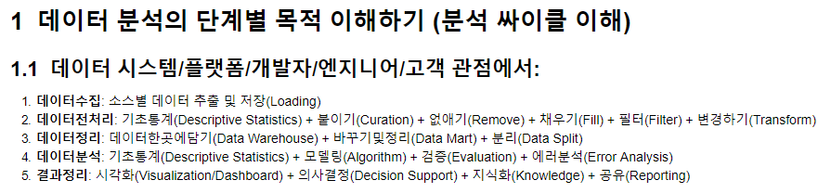
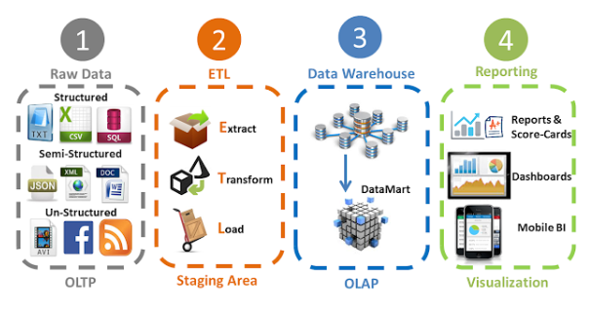

Slide 2
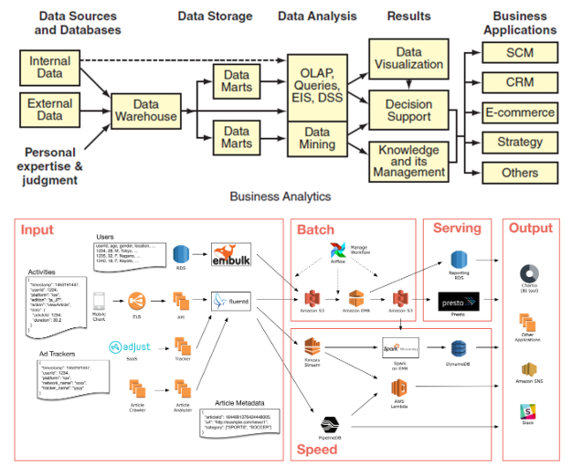

Slide 3
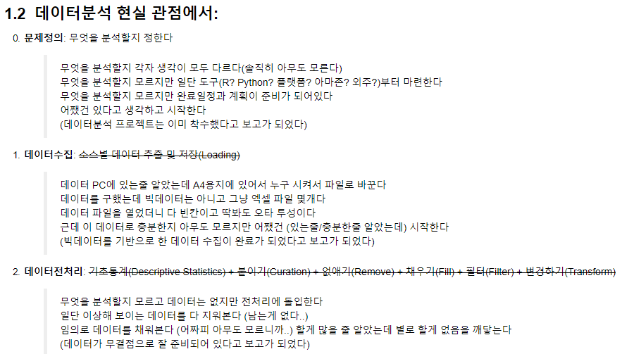

Slide 4
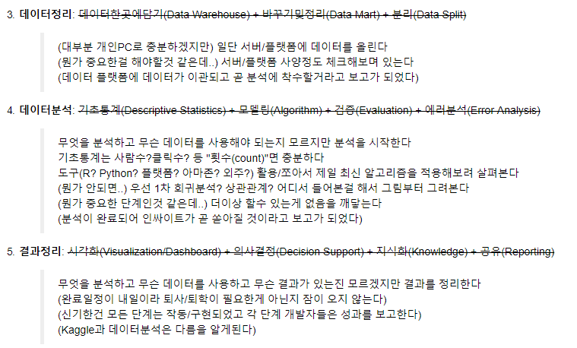

Slide 5


Slide 6
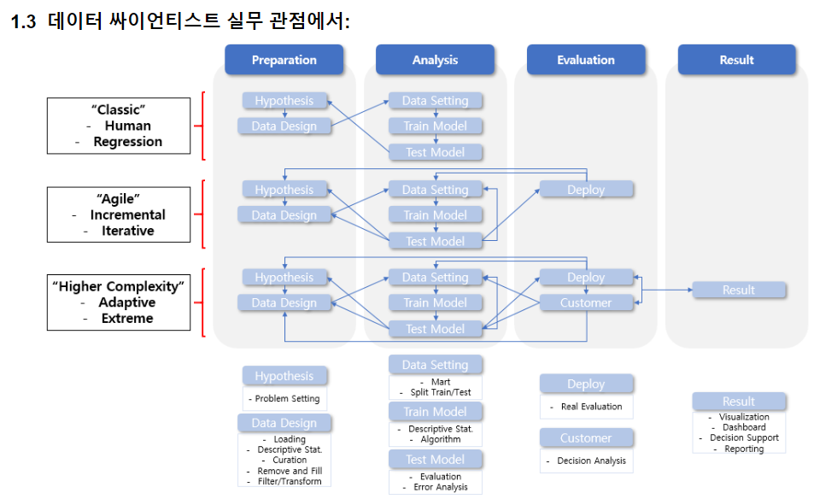

Slide 7
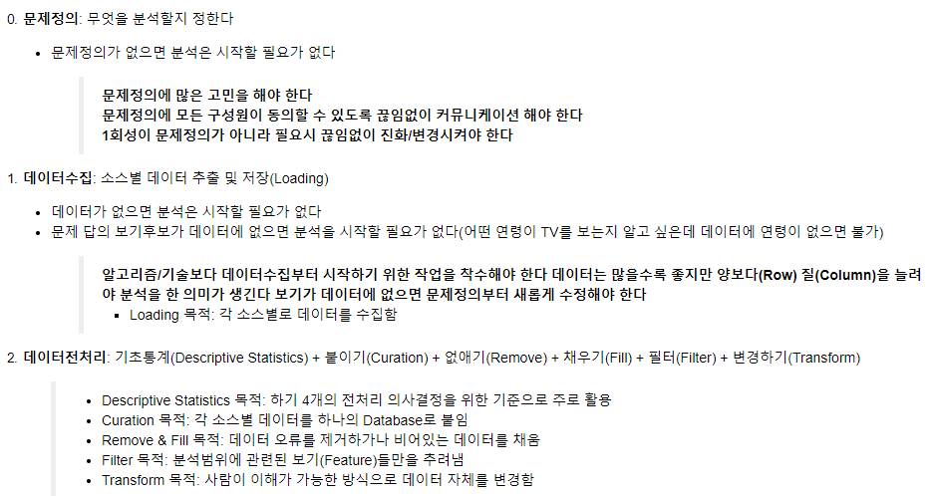

Slide 8
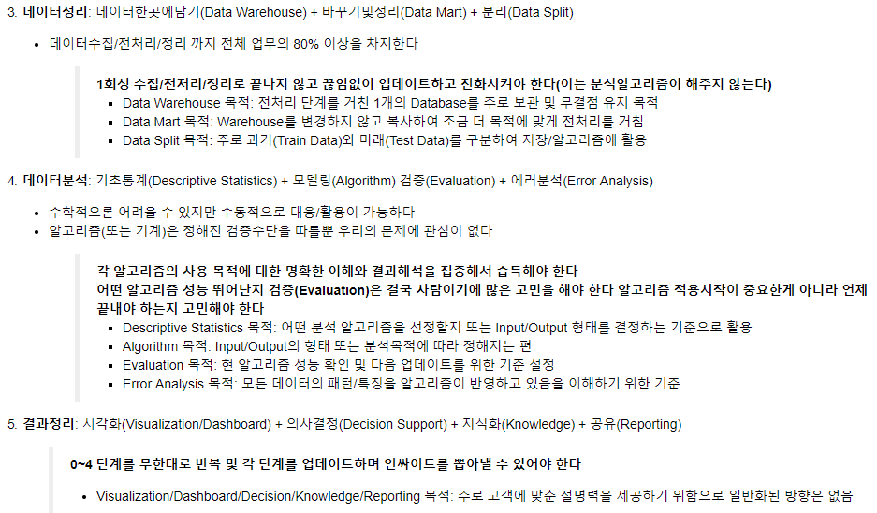

Slide 9
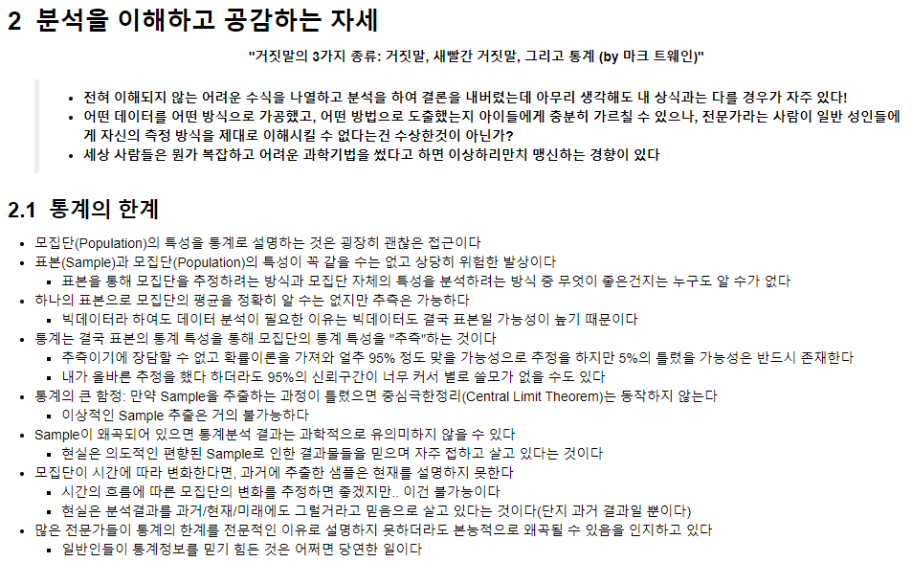

Slide 10
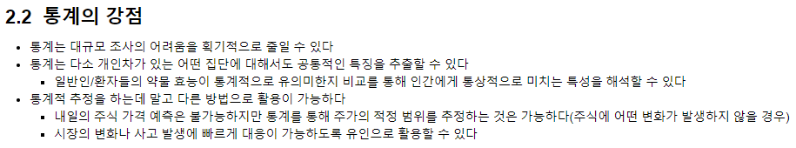

Slide 11
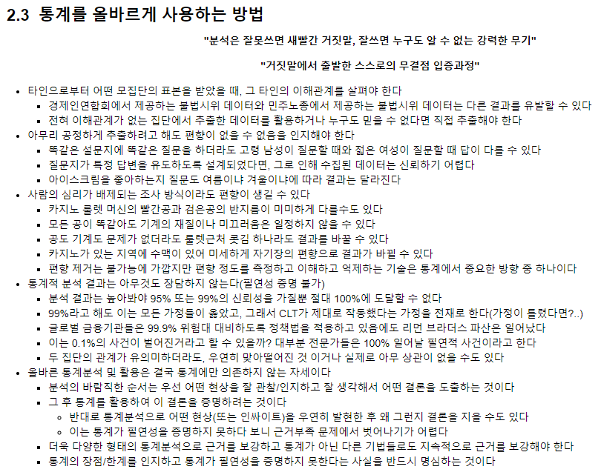

Slide 13
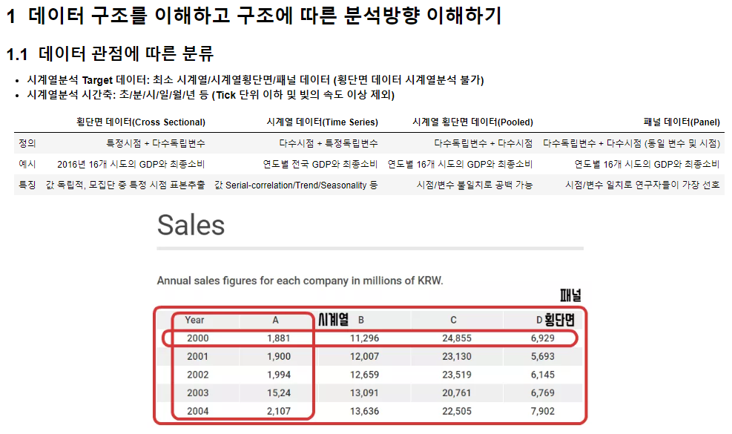

Slide 14
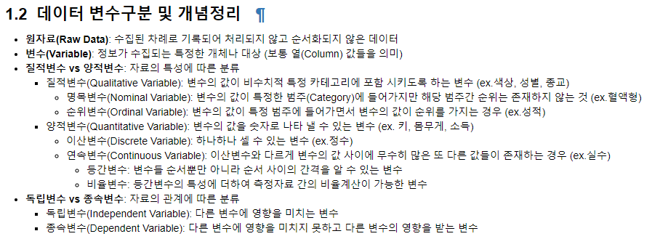

Slide 15
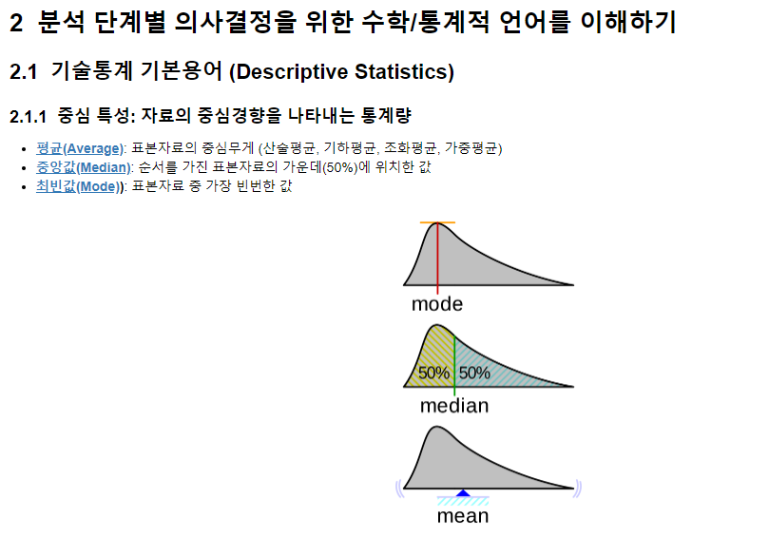

Slide 16
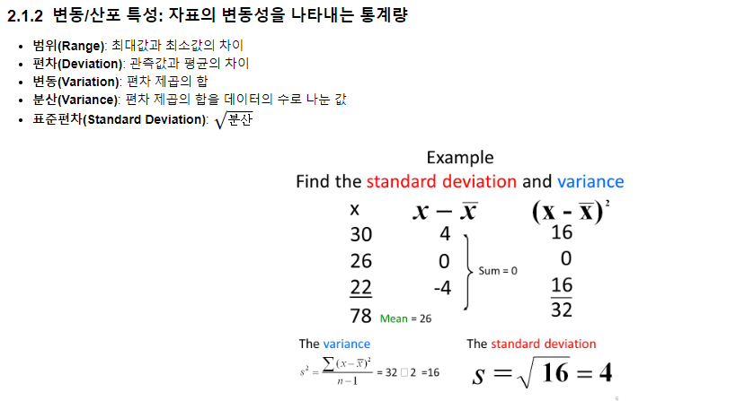

Slide 17
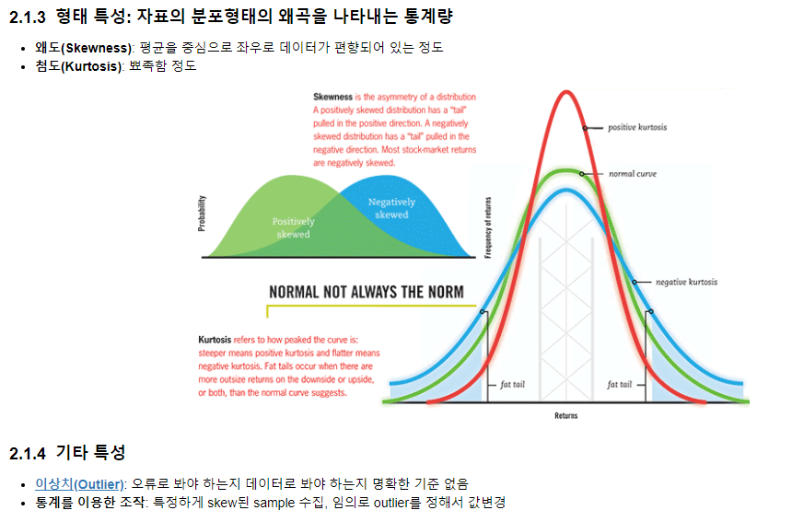

Slide 18
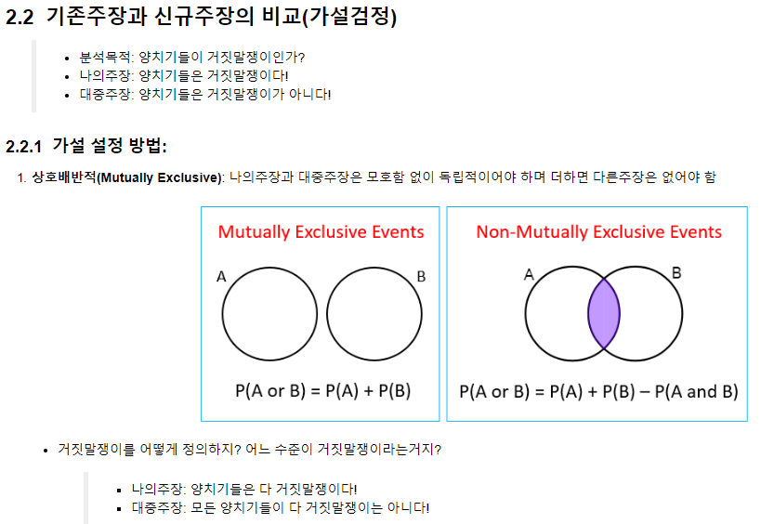

Slide 19
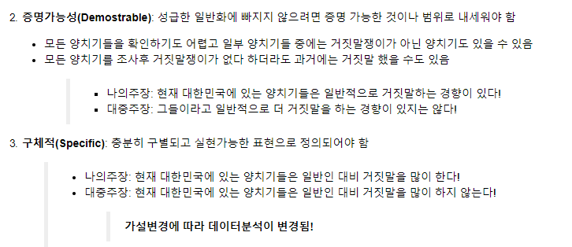

Slide 20
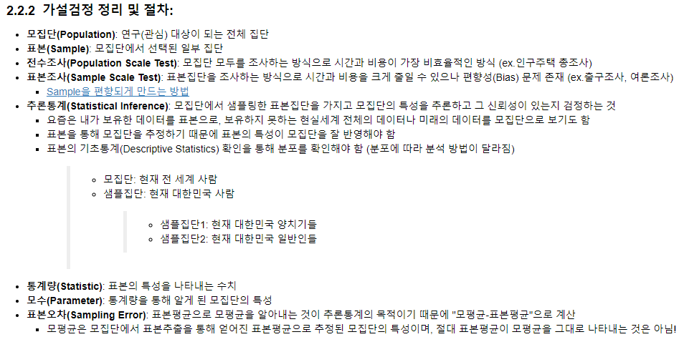

Slide 21
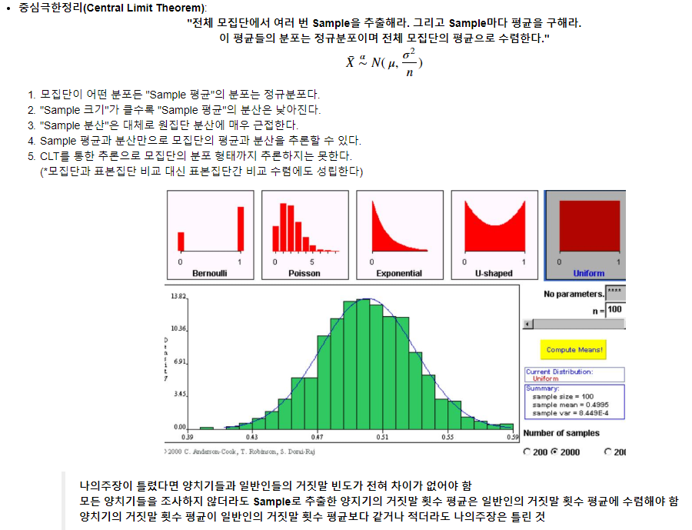

Slide 22
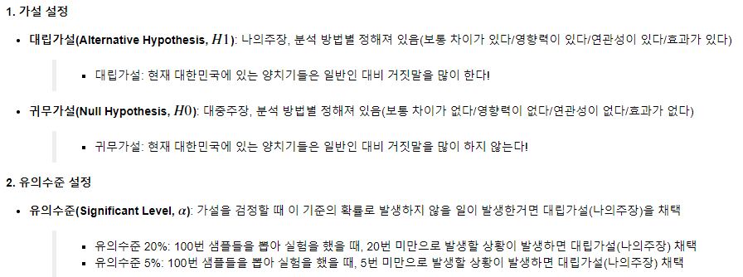

Slide 23
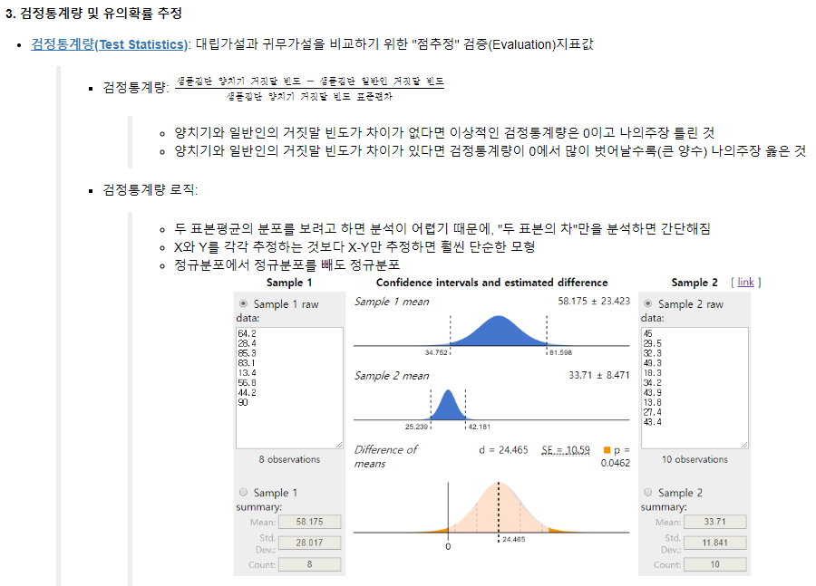

Slide 24
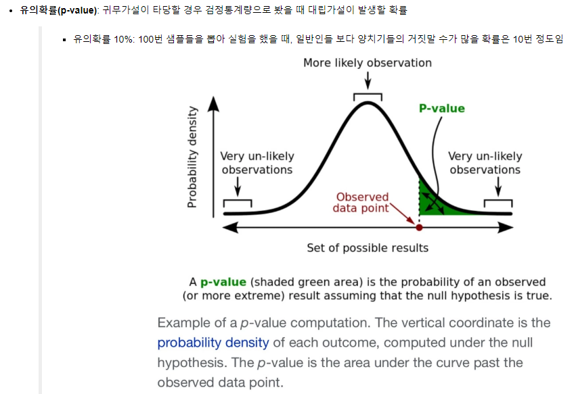

Slide 25
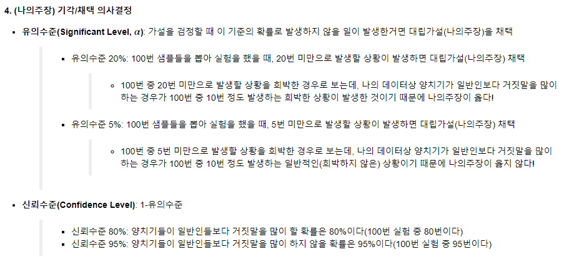

Slide 26
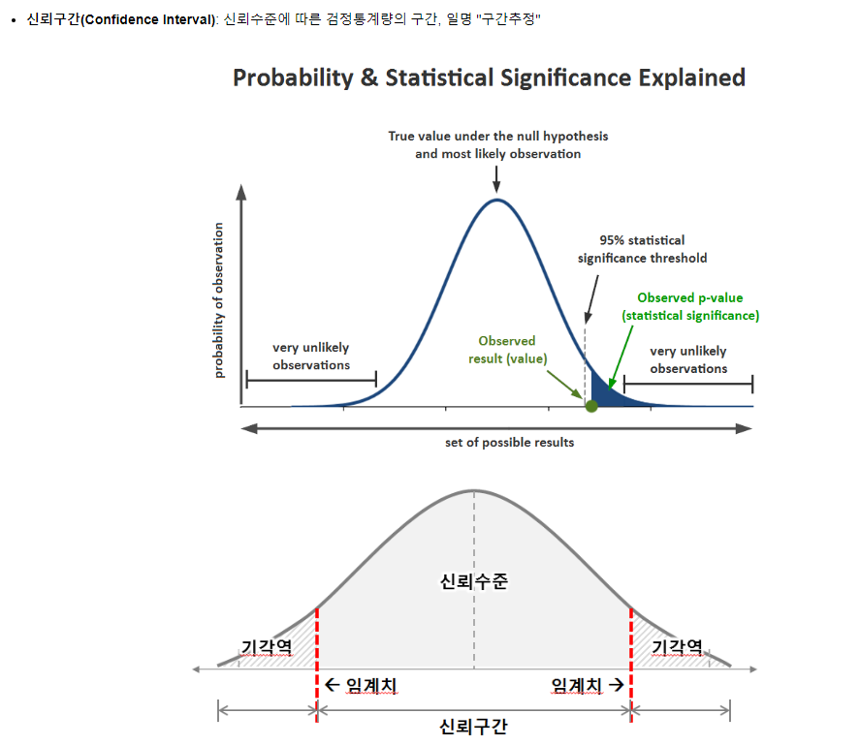

Slide 27
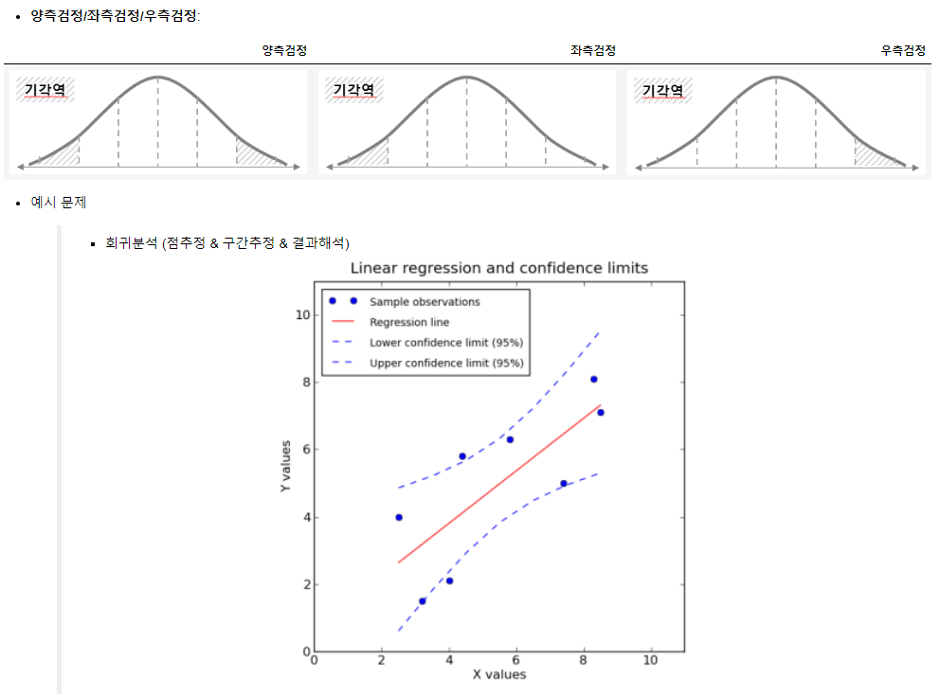

Slide 28
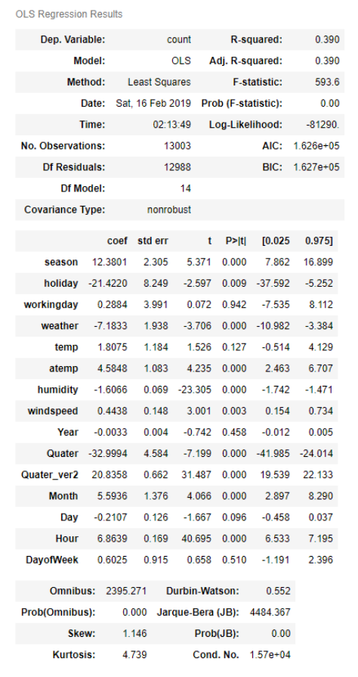

Slide 29


Slide 30
Preparation
Analysis
Evaluation
Result
Part1. 분석싸이클 및 언어이해(1주차)
“Classic”
Human
Regression
Hypothesis
Data Setting
Data Design
Train Model
Test Model
“Agile”
Incremental
Iterative
Hypothesis
Data Setting
Deploy
Data Design
Train Model
Test Model
“Higher Complexity”
Adaptive
Extreme
Hypothesis
Data Setting
Deploy
Result
Data Design
Train Model
Customer
Test Model
Data Setting
Hypothesis
Mart
Split Train/Test
Deploy
- Problem Setting
Real Evaluation
Result
Train Model
Data Design
Visualization
Dashboard
Decision Support
Reporting
Descriptive Stat.
Algorithm
Customer
Loading
Descriptive Stat.
Curation
Remove and Fill
Filter/Transform
Test Model
Decision Analysis
Evaluation
Error Analysis

Slide 31
Preparation
Analysis
Evaluation
Result
Part1. 시계열분석 준비(2주차)
“Classic”
Human
Regression
Hypothesis
Data Setting
Data Design
Train Model
Test Model
“Agile”
Incremental
Iterative
Hypothesis
Data Setting
Deploy
Data Design
Train Model
Test Model
“Higher Complexity”
Adaptive
Extreme
Hypothesis
Data Setting
Deploy
Result
Data Design
Train Model
Customer
Test Model
Data Setting
Hypothesis
Mart
Split Train/Test
Deploy
- Problem Setting
Real Evaluation
Result
Train Model
Data Design
Visualization
Dashboard
Decision Support
Reporting
Descriptive Stat.
Algorithm
Customer
Loading
Descriptive Stat.
Curation
Remove and Fill
Filter/Transform
Test Model
Decision Analysis
Evaluation
Error Analysis

Slide 32
Preparation
Analysis
Evaluation
Result
Part2. 비교를 위한
Base분석(ML) 준비(3주차)
“Classic”
Human
Regression
Hypothesis
Data Setting
Data Design
Train Model
Test Model
“Agile”
Incremental
Iterative
Hypothesis
Data Setting
Deploy
Data Design
Train Model
Test Model
“Higher Complexity”
Adaptive
Extreme
Hypothesis
Data Setting
Deploy
Result
Data Design
Train Model
Customer
Test Model
Data Setting
Hypothesis
Mart
Split Train/Test
Deploy
- Problem Setting
Real Evaluation
Result
Train Model
Data Design
Visualization
Dashboard
Decision Support
Reporting
Descriptive Stat.
Algorithm
Customer
Loading
Descriptive Stat.
Curation
Remove and Fill
Filter/Transform
Test Model
Decision Analysis
Evaluation
Error Analysis

Slide 33
Preparation
Analysis
Evaluation
Result
Part3. 시계열분석 모델이해
및 성능향상(4~7주차)
“Classic”
Human
Regression
Hypothesis
Data Setting
Data Design
Train Model
Test Model
“Agile”
Incremental
Iterative
Hypothesis
Data Setting
Deploy
Data Design
Train Model
Test Model
“Higher Complexity”
Adaptive
Extreme
Hypothesis
Data Setting
Deploy
Result
Data Design
Train Model
Customer
Test Model
Data Setting
Hypothesis
Mart
Split Train/Test
Deploy
- Problem Setting
Real Evaluation
Result
Train Model
Data Design
Visualization
Dashboard
Decision Support
Reporting
Descriptive Stat.
Algorithm
Customer
Loading
Descriptive Stat.
Curation
Remove and Fill
Filter/Transform
Test Model
Decision Analysis
Evaluation
Error Analysis

Slide 34
Preparation
Analysis
Evaluation
Result
Part4. 신규 시계열분석 모델링 및 문제해결(8주차)
“Classic”
Human
Regression
Hypothesis
Data Setting
Data Design
Train Model
Test Model
“Agile”
Incremental
Iterative
Hypothesis
Data Setting
Deploy
Data Design
Train Model
Test Model
“Higher Complexity”
Adaptive
Extreme
Hypothesis
Data Setting
Deploy
Result
Data Design
Train Model
Customer
Test Model
Data Setting
Hypothesis
Mart
Split Train/Test
Deploy
- Problem Setting
Real Evaluation
Result
Train Model
Data Design
Visualization
Dashboard
Decision Support
Reporting
Descriptive Stat.
Algorithm
Customer
Loading
Descriptive Stat.
Curation
Remove and Fill
Filter/Transform
Test Model
Decision Analysis
Evaluation
Error Analysis

